Slide 1
Government Contracting: A Basic Guide and Tutorial
Mary Lynn Landgraf
Senior International Trade Specialist
OTEXA
October 7, 2015
IFAI Expo
Anaheim, CA
Research Assistant and Intern: Catrina Corley

Slide 2
Critical Components of this Presentation
OTEXA Services
Selling to the U.S. Government
Manufacturing Innovation Institute
Small Business Administration
Exporting Guidelines

Slide 3
U.S. Department of Commerce Office of Textiles and Apparel (OTEXA)
Develops programs and strategies to improve the domestic and international competitiveness of the U.S. fiber, textile, apparel, footwear, and travel goods industries
The Deputy Assistant Secretary (DAS) is the Chairman of Committee for the Implementation of Textile Agreements (CITA).
CITA was established by the President in Executive Order 11651 on March 3, 1972.
OTEXA provides the staff support for the Committee, monitors all agreements, provides economic analysis, and statistical data upon which the Committee relies in taking action.
http://otexa.trade.gov

Slide 4
U.S. Department of Commerce Office of Textiles and Apparel (OTEXA)
Compiles industry data
Conducts research and analysis
Assists in trade negotiations
Promotes U.S. textile and apparel companies at trade events
Develops supply chain and sourcing strategies
Executes U.S. textile and apparel trade policy
Works to improve exports of U.S. textile and apparel companies in overseas markets
Evaluates the current state of the domestic fiber, textile and apparel industries, and the impact of import competition
http://otexa.trade.gov

Slide 5
U.S. Department of Commerce Office of Textiles and Apparel (OTEXA)
OTEXA has over 40 years of experience in facilitating exports for small and medium-sized companies:
Export counseling and assistance
Market research
U.S. Pavilions at established overseas trade shows
Trade missions
Catalog/sample presentations at overseas trade shows
https://pixabay.com/get/8db094da5ecb36f202fe/1442851601/container-ship-560789_1280.jpg
http://otexa.trade.gov

Slide 6
U.S. Department of Commerce Office of Textiles and Apparel (OTEXA)
With increasing demands by consumers, brands and retailers for “Made-in-USA” products, OTEXA has developed an online registry that will showcase domestic manufacturers, suppliers of apparel, textiles, and footwear.
To register as a supplier or manufacturer, or to locate domestic producers and suppliers, contact:
Kim-Bang Nguyen
kim-bang.nguyen@trade.gov
202-482-4805
http://cdn.shopify.com/s/files/1/0177/0548/files/Made-in-USA_large.png?1387
http://otexa.trade.gov

Slide 7
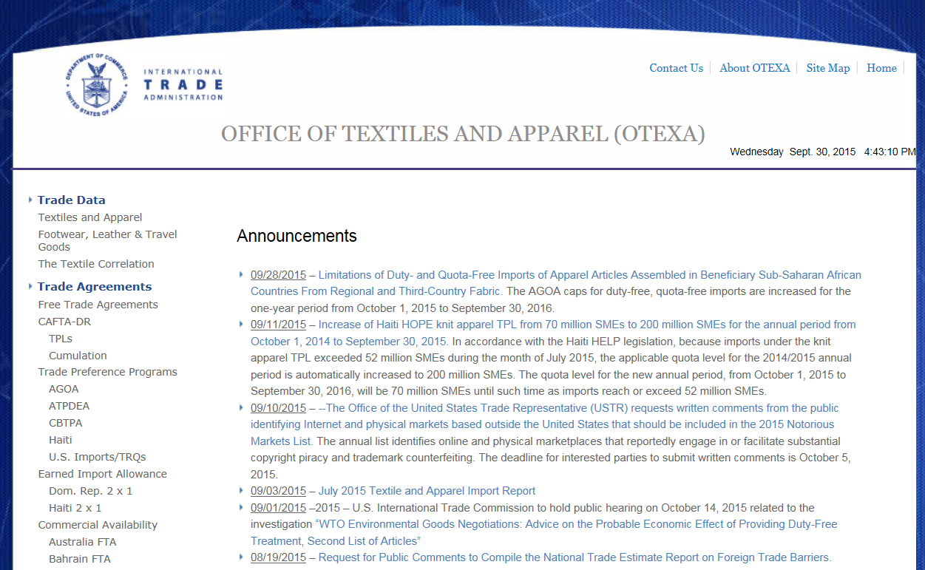
U.S. Department of Commerce Office of Textiles and Apparel (OTEXA)
With increasing demands by consumers, brands and retailers for “Made-in-USA” products, OTEXA has developed an online registry that will showcase domestic manufacturers, suppliers of apparel, textiles, and footwear.
http://otexa.trade.gov

Slide 8
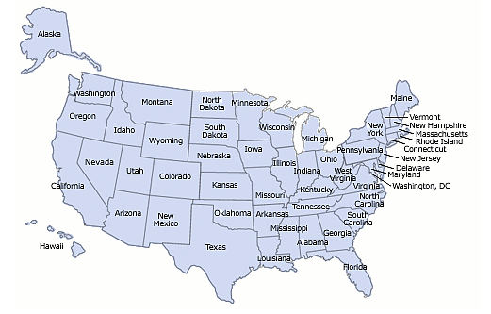
Made in the U.S.A. Database
http://otexa.trade.gov/MadeInUSA.htm

Slide 9
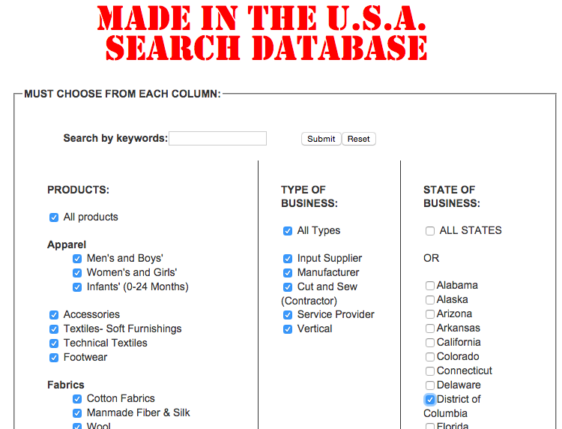
Made in the U.S.A. Database
Search with or without keyword by product, type of business, or state.
http://otexa.trade.gov/MadeInUSA.htm

Slide 10
DoD Procurement of Clothing & Textiles (The Berry Amendment)
The Department of Defense (DoD) required by law, 10 U.S.C. 2533A in Section 832 of Public Law 107-107, to procure domestically-manufactured clothing and textiles.
Purpose – to maintain an active industrial base in times of war
Generally applied on a fiber-forward basis
In FY 2014, the Defense Logistic Agency’s sales of clothing, textiles & equipment to military personnel worldwide surpassed $1.9 billion
Over 8,000 different items procured, ranging from uniforms, footwear and undergarments to ecclesiastical items, individual equipment, flags, tents
OTEXA provides match-making services to U.S. companies wishing to sell to the military, both here and overseas
https://upload.wikimedia.org/wikipedia/commons/a/a8/U.S._Army_service_dress_uniform.jpg
http://www.otexa.ita.doc.gov/berry.htm

Slide 11
Contact for The Berry Amendment
The Department of Defense (DoD) required by law, 10 U.S.C. 2533A in Section 832 of Public Law 107-107, to procure domestically-manufactured clothing and textiles.
Maria D’Andrea
Supervisory International Trade Specialist
Office of Textiles and Apparel
Industry and Analysis
International Trade Administration
U.S. Department of Commerce
Maria.Dandrea@trade.gov
Telephone: 202-482-1550
https://upload.wikimedia.org/wikipedia/commons/a/a8/U.S._Army_service_dress_uniform.jpg
http://www.otexa.ita.doc.gov/berry.htm

Slide 12
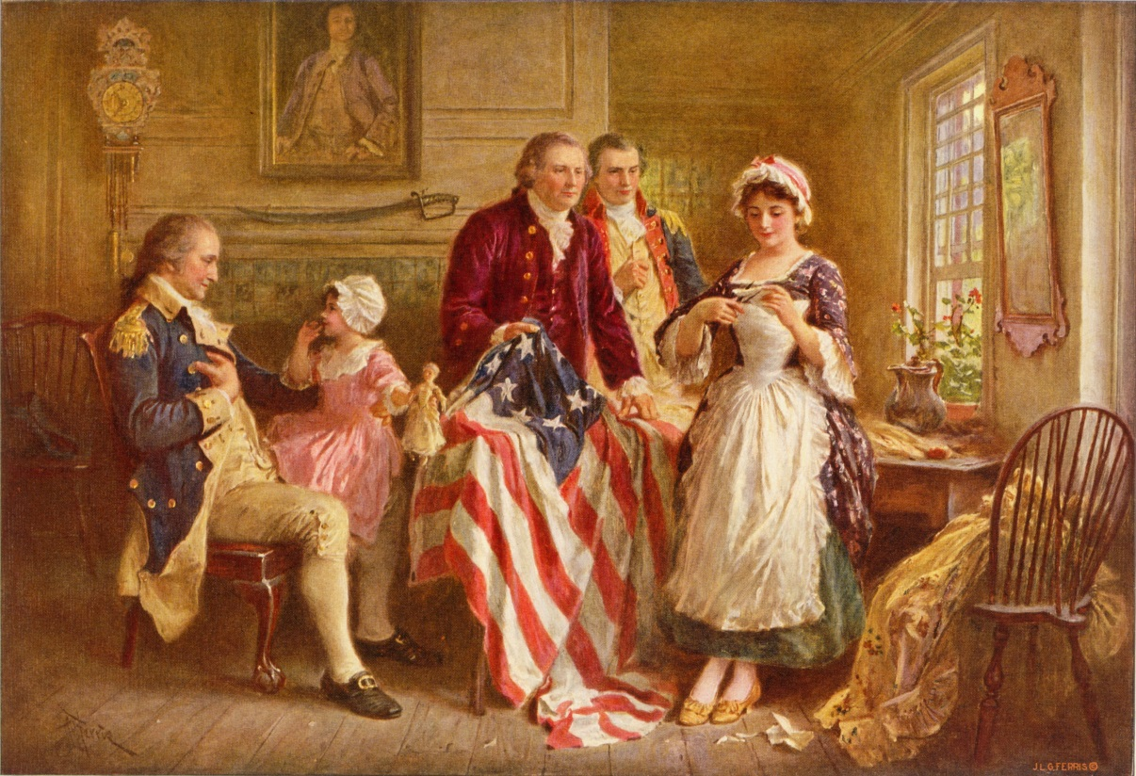
The Buy American Act of 1933
Federal agencies are required to buy domestic goods/construction materials.
Domestic is defined as being manufactured in the United States and the cost of domestic components must exceed 50 % of the cost of all components.
Establishes price preferences for domestic. Federal agencies can waive the domestic requirement
Betsy Ross 1777 by Jean Leon Gerome Ferris – Public Domain
https://commons.wikimedia.org/wiki/File:Betsy_Ross_1777_cph.3g09905.jpg
for reasons of price,
non-availability of domestic, and public interest (“public interest” is undefined).
Under the Trade Agreement Act of 1979, if a procurement is covered under a trade agreement, then the Buy American Act of 1933 is waived.

Slide 13
The Buy American Act of 1933
In those situations, Federal agencies can only buy either the domestic products or products from trade agreement countries. Trade agreements include all of our FTA’s (except the U.S.-Jordon FTA) or the WTO Agreement on Government Procurement (GPA).
GPA is a plurilateral agreement that includes 46 countries including the United States. Mostly developed nations such as Canada, the EU member states, Japan, Korea, Singapore, Switzerland.
Important note: what is “covered” and what is excluded from our trade agreements. For purposes of textiles, there are exclusions that can be found in all our trade agreements.
Annex 1 (central government entities) GPA states for the DoD the Agreement doesn’t cover:
FSC 83 Textiles, Leather, Furs, Apparel, Shoes, Tents, and Flags (all elements other than pins, needles, sewing kits, flagstaffs, flagpoles and flagstaff trucks)
FSC 84 Clothing, Individual Equipment, and Insignia (all elements other than sub-class 8460 – luggage)
https://c1.staticflickr.com/5/4112/5061049945_3a185fc6ea_b.jpg

Slide 14
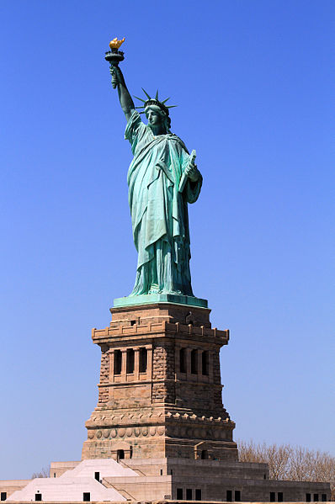
The Buy American Act of 1933 Contact
Brian Woodward
Senior International Trade Specialist
Trade Agreements, Negotiation and Compliance
Office of Textiles and Apparel
Industry and Analysis
International Trade Administration
U.S. Department of Commerce
Brian.Woodward@trade.gov
Telephone: 202-482-0375
https://commons.wikimedia.org/wiki/File:USA-NYC-Statue_of_Liberty.jpg#/media/File:USA-NYC-Statue_of_Liberty.jpg
http://www.otexa.ita.doc.gov/berry.htm

Slide 15
MADE: In America
MADE: In America, headquartered on Capitol Hill in Washington, DC, was established to be a unique voice and advocate for American manufacturers. Since its inception, MADE: In America has created coalitions across the United States to revitalize American small business.
Starting in 2008, MADE: In America has created innovative initiatives in support of the American home furnishings industry. Most recently, MADE: In America, in cooperation with the National Trust for Historic Preservation, launched the highly successful All American House. Over two years in the making, the All American house has provided a new template for interpreting historic house properties and showcasing America's best products.
http://media-cdn.tripadvisor.com/media/photo-s/02/6d/02/9c/charles-carroll-house.jpg
Carroll Mansion wins designation as All American House 2016 - Baltimore City to receive first-in-the-Nation All American City Award
http://www.madeinamerica-usa.org

Slide 16
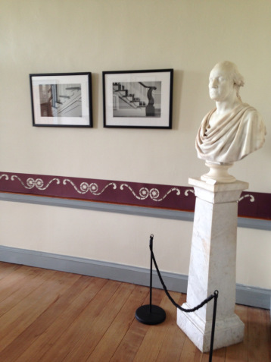
MADE: In America
The Department of Commerce, Office of Textiles and Apparel, will be cooperating with MADE: In America on the 2016 All American House, which will incorporate the yet to be announced Art of Living initiative. This initiative will include not only U.S. home textile producers, but textile apparel manufacturers will be eligible as well.
The parlor at the All American House designed by students from UNCG
http://www.madeinamerica-usa.org

Slide 17
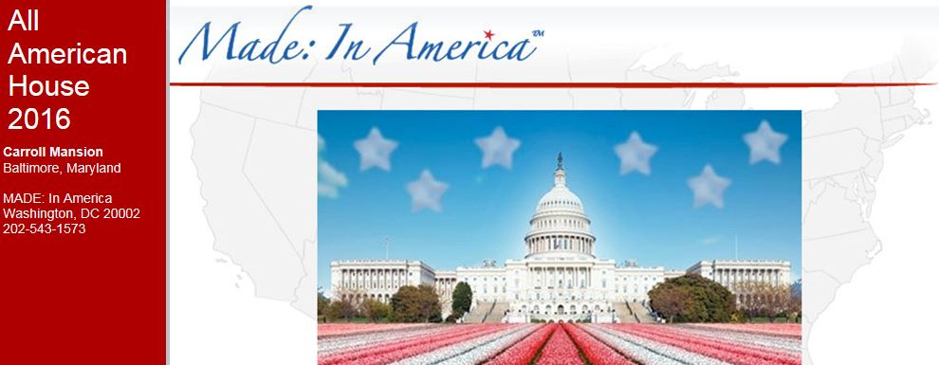
MADE: In America
For more information about the All American House and the Art of Living program,
interested companies are encouraged to contact
MADE: In America Chairman
James De Lorbe
202-543-1573
james.delorbe@madeinamerica-usa.com
http://www.madeinamerica-usa.org

Slide 18
Selling to the Federal Government
In order to do business with the Federal Government to include the Department of State, there are required procedures you must follow.
The first and most critical step is online registration with the Federal Government’s System for Award Management (SAM).
Once registered, your company will be able to sell to all Federal Agencies that have an interest in your products. Registration enables purchase orders to be sent to your company as well as payments to be made via electronic funds transfer (EFT) for goods received.
Visit the System for Award Management website at http://www.sam.gov
Acquire your DUNS number at http://fedgov.dnb.com/webform or call at 1-866-705-5711.
Obtain the North American Industrial Classification System (NAICS) industry codes for your business http://www.census.gov/eos/www/naics/index.html
http://www.sam.gov

Slide 19
Selling to the Federal Government
If you are interested in selling your products to the U.S. Department of State for federal buildings, embassies, ambassador’s residences, etc., around the world, please submit your
contact details, and summary of your company’s products to
Mary-Lynn.Landgraf@trade.gov.
The summary will be forwarded to the special office for review. Upon acceptance, you will be contacted, and listed in the U.S. State Department’s procurement system.
Lithuanian Embassy Interior
https://upload.wikimedia.org/wikipedia/commons/e/e6/Lithuanian_Embassy_Interior_-_Flickr_-_Mr._T_in_DC.jpg
http://www.sam.gov

Slide 20
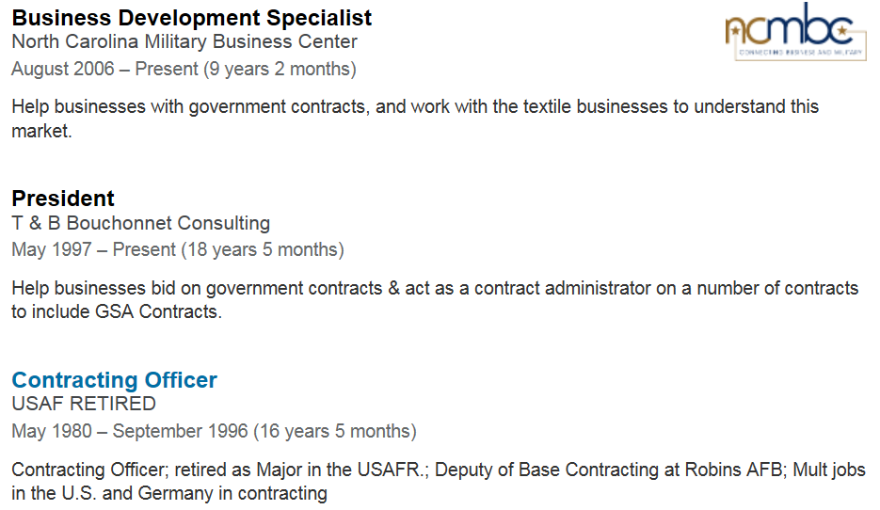
Contracting Expertise
Focus Areas and Experience:
Textiles
Defense Logistics Agency Troop Support Clothing & Textiles
Defense Logistics Agency Construction and Equipment
US Army TACOM (NATICK)
Registered with SAM
Has won contracts

Slide 21
Contracting Expertise
Teresa’s web training classes will be free for Small Businesses through the SBA and T&B Bouchonnet Consulting, a subcontractor for Stover & Associates, Inc.
Teresa Bouchonnet
T & B Bouchonnet Consulting
E-mail: bouchonnet@frontier.com
Phone: 828-349-3878
Teresa also helps textile businesses in North Caroline through the N.C. Military Business Center.
Teresa Bouchonnet
E-mail: bouchonnett@ncmbc.us
Phone: 828-349-3878
http://www.ncmbc.us/contact-us/contact-bouchonnett.php

Slide 22
Defense Logistics Agency (DLA) and DIBBS
DLA Internet Bid Board System (DIBBS)
Provides access to DLA’s solicitations.
Can search, view, and submit secure quotes on Requests For Quotations (RFQs) for DLA items of supply.
Can search and view Requests for Proposals (RFPs), Invitations For Bid (IFBs), and other procurement information
https://www.dibbs.bsm.dla.mil/

Slide 23
Defense Logistics Agency (DLA) and DIBBS
Continued
DLA Internet Bid Board System (DIBBS)
Search the Awards through the DLA Awards Database.
Can find all the Mil Specs
Go to “Technical Data”
Find “ASSIST Quick Search”
Search for item via document ID, document number, keyword, etc.
http://quicksearch.dla.mil

Slide 24
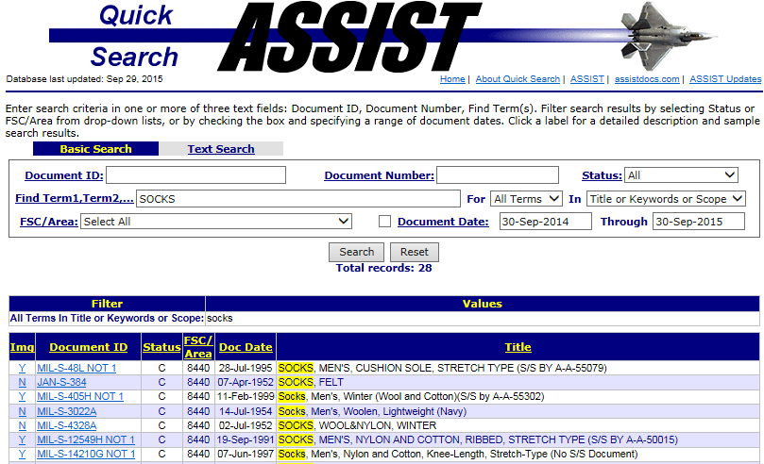
Defense Logistics Agency (DLA) and DIBBS
Continued
Example of ASSIST Quick Search for “Socks”
http://quicksearch.dla.mil

Slide 25
General Services Administration (GSA)
GSA provides centralized procurement for the federal government, offering billions of dollars worth of products, services, and facilities that federal agencies need to serve the public.
GSA serves the public and makes government easier by offering free access to and information about government programs with these websites:
USA.gov, official portal to federal government information;
gobiernoUSA.gov, Spanish counterpart of USA.gov;
publications.USA.gov, Federal Citizen Information Center;
Consumer protection on USA.gov, consumer action website;
Consumer protection in Spanish on goviernoUSA.gov;
kids.gov, official kids portal for the U.S. Government.
National Customer Service CenterDSN 465-1416 Phone: (800) 488-3111 E-mail: mashelpdesk@gsa.gov
http://www.gsa.gov

Slide 26
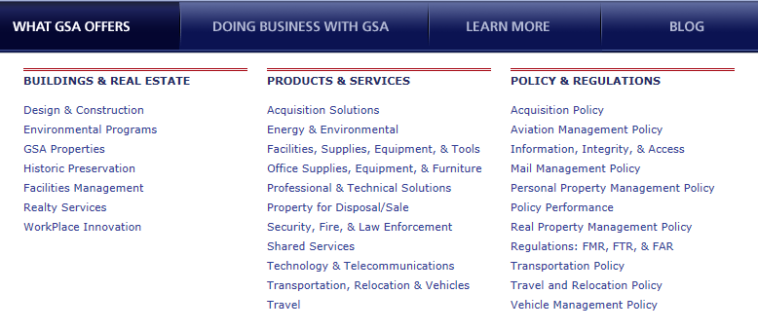
General Services Administration (GSA)
GSA provides centralized procurement for the federal government, offering billions of dollars worth of products, services, and facilities that federal agencies need to serve the public.
http://www.gsa.gov

Slide 27
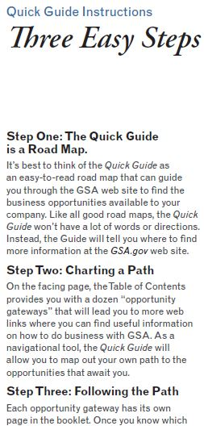
General Services Administration (GSA)
GSA developed a Quick Guide with easy steps on how to use the service.
You can download the Quick Guide using the link below:
http://www.gsa.gov/portal/mediaId/169031/fileName/2013_DB_AQuickGuideEngishFINAL.action
http://www.gsa.gov

Slide 28
Common Acquisition Platform (CAP)
GSA, whose singular mission is to deliver the best value in acquisitions to government and the American people, is leading the initiative.
The Common Acquisition Platform (CAP) office develops, manages, and delivers shared services offerings to the government-wide acquisition community.
To enable these capabilities, CAP is designing and implementing these shared services:
Analytics as a Service (AaaSSM)
TurboFARSM
eBuy Open
www.gsa.gov/cap

Slide 29
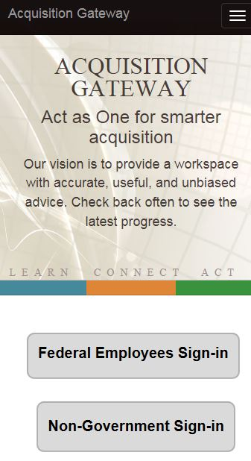
Acquisition.gov
A comprehensive, user-friendly hub for contracting officers (COs), that allows them to electronically search past and present versions of the Federal Acquisition Regulation (FAR) and GSA Acquisition Manual (GSAM), and stay-up-to-date on the latest developments in federal acquisition.
In addition, the new website organizes other acquisition resources (i.e. Supplemental Regulations, Acquisition Systems, Training) into clear, comprehensive categories – providing easy access to the resources that COs use most often.
https://hallways.cap.gsa.gov/login-information
https://www.acquisition.gov/

Slide 30
Procurement Technical Assistance Center (PTAC)
Procurement Technical Assistance Centers (PTACs) provide local, in-person counseling and training services for you, the small business owner. They are designed to provide technical assistance to businesses that want to sell products and services to federal, state, and/or local governments. PTAC services are available either free of charge, or at a nominal cost. PTACs are part of the Procurement Technical Assistance Program, which is administered by the Defense Logistics Agency.
What can a PTAC do for you?
Determine if your business is ready for government contracting.
Help you register in the proper places.
See if you are eligible in any small business certifications.
Research past contract opportunities.
http://www.dla.mil/smallbusiness/pages/ptac.aspx

Slide 31
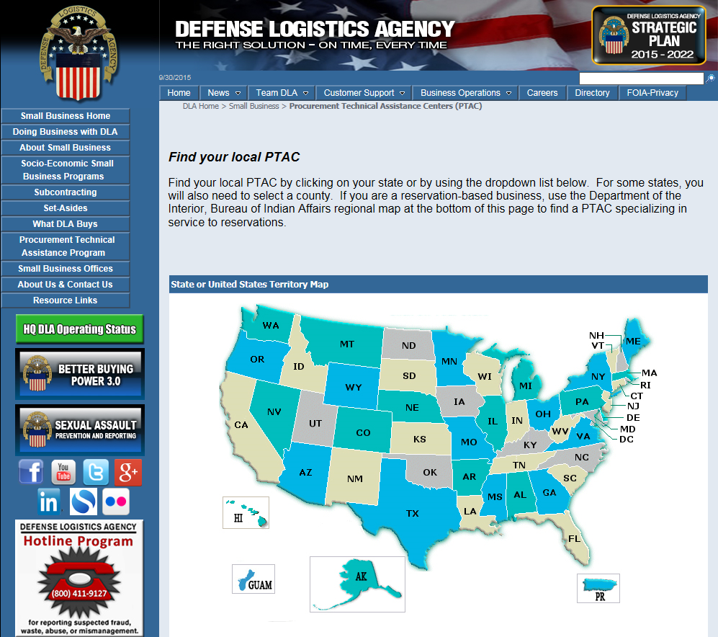
Procurement Technical Assistance Center (PTAC)
Find your local PTAC:
To find your local PTAC visit http://www.dla.mil/smallbusiness/pages/ptac.aspx
Click on your state or by using the dropdown list below
For some states, you will also need to select a county
http://www.dla.mil/smallbusiness/pages/ptac.aspx

Slide 32
National Contract Management Association (NCMA)
If you are serious about government contracting, become a member of NCMA.
What is NCMA?
The National Contract Management Association (NCMA), founded in 1959, is the world’s leading professional resource for those in the field of contract management. The organization, which has over 20,000 members, is dedicated to the professional growth and educational advancement of procurement and acquisition personnel worldwide. NCMA strives to serve and inform the profession it represents and to offer opportunities for the open exchange of ideas in neutral forums.
http://www.ncmahq.org/

Slide 33
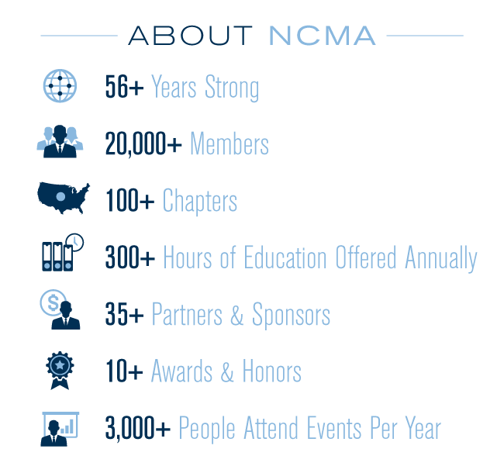
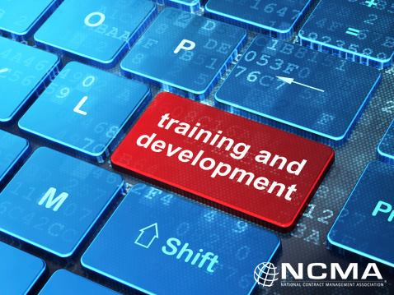
National Contract Management Association (NCMA)
http://www.ncmahq.org/

Slide 34
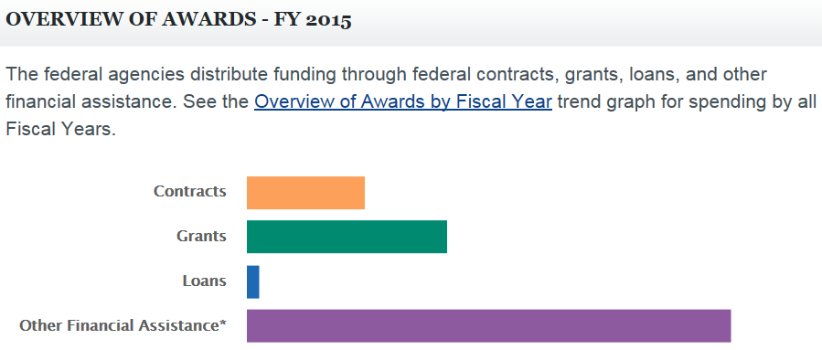
USASpending.gov
The Federal Funding Accountability and Transparency Act of 2006 (FFATA) was signed into law on September 26, 2006. The legislation required that federal contract, grant, loan, and other financial assistance awards of more than $25,000 be displayed on a searchable, publicly accessible website, USAspending.gov, to give the American public access to information on how their tax dollars are being spent. As a matter of discretion, USAspending.gov also displays certain federal contract​s of more than $3,000.
Federal agencies are required to report the name of the entity receiving the award, the amount of the award, the recipient’s location, the place of performance location, as well as other information.
https://www.usaspending.gov

Slide 35
America’s Seed Fund - SBIR
Small Business Innovation Research (SBIR)
The program’s goals are four-fold:
Stimulate technological innovation
Meet Federal research and development needs
Foster and encourage participation in innovation and entrepreneurship by socially and economically disadvantaged persons
Increase private-sector commercialization of innovations derived from Federal research and development funding
The Small Business Innovation Research (SBIR) program is a highly competitive program that encourages domestic small businesses to engage in Federal Research/Research and Development (R/R&D) that has the potential for commercialization.
Through a competitive awards-based program, SBIR enables small businesses to explore their technological potential and provides the incentive to profit from its commercialization.
https://www.sbir.gov

Slide 36
America’s Seed Fund - STTR
Small Business Technology Transfer (STTR)
The programs’ goals are to:
Stimulate technological innovation
Foster and encourage participation in innovation and entrepreneurship by socially and economically disadvantaged persons
Increase private-sector commercialization of innovations derived from Federal research and development funding
The Small Business Technology Transfer (STTR) is another program that expands funding opportunities to include the joint venture opportunities for small businesses and nonprofit research institutions in the federal innovation research and development (R&D) arena.
STTR's most important role is to bridge the gap between performance of basic science and commercialization of resulting innovations.
https://www.sbir.gov/about/about-sttr

Slide 37
The Internet of Things: Game Changers
Source: Stained Glass Labs

Slide 38
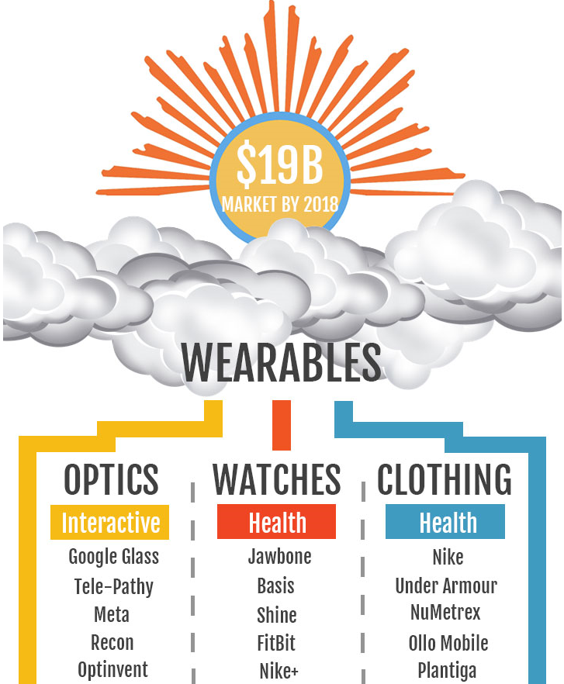
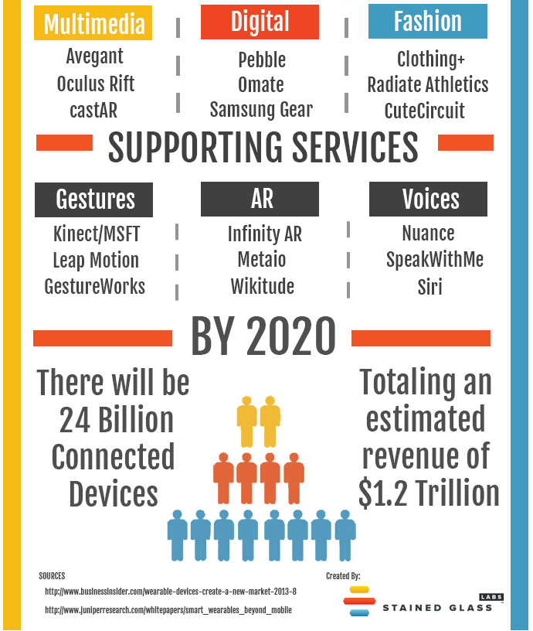
The Internet of Things: Game Changers
Source: Stained Glass Labs

Slide 39
Manufacturing Innovation Institute
The National Network for Manufacturing Innovation (NNMI) consists of multiple linked Institutes for Manufacturing Innovation with common goals but unique technological concentrations.
Institutes catalyze the development of new technologies, educational competencies, production processes, and products via shared contributions from the public, private sectors, and academia.
http://www.manufacturing.gov

Slide 40
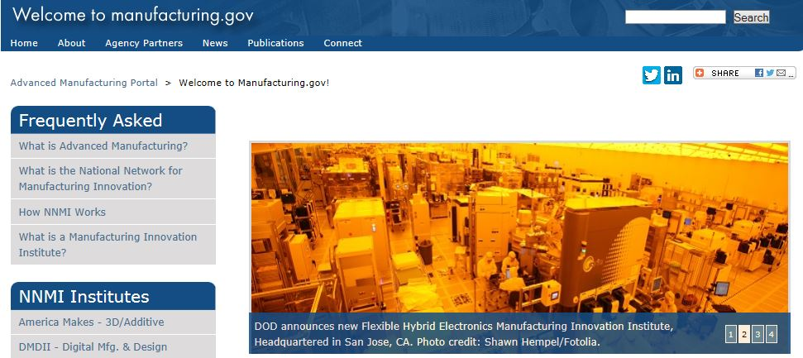
Manufacturing Innovation Institutes
Individual institutes serve as a regional hub in their area
Bridges gap between applied research and product development
Encourages investment and production in their region and in the United States.
Designed to foster innovation
http://www.manufacturing.gov

Slide 41
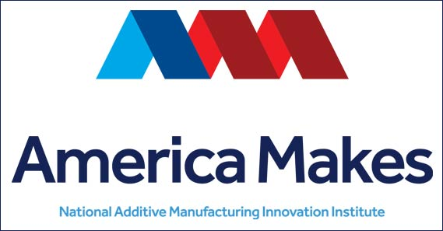
America Makes
Date Launched: Aug. 16, 2012
Focus Area: Additive Manufacturing
http://americamakes.us/
Capsule Summary: America Makes focuses on helping the United States grow capabilities and strength in 3D printing, also known as additive manufacturing. America Makes facilitates collaboration among leaders from business, academia, nonprofit organizations and government agencies, focusing on areas that include design, materials, technology and workforce and help our nation’s three-dimensional (3D) printing industry become more globally competitive.
http://www.manufacturing.gov

Slide 42
Digital Manufacturing and Design Innovation Institute (DMDII)
Date Launched: Feb. 25, 2014
Focus Area: Integrated Digital Design and Manufacturing
http://dmdii.uilabs.org
Capsule Summary: The DMDII is the nation’s flagship research institute for applying cutting-edge digital technologies to reduce the time and cost of manufacturing, strengthen the capabilities of the U.S. supply chain and reduce acquisition costs for the U.S. Department of Defense (DoD). The DMDII develops and demonstrates digital manufacturing technologies, and deploys and commercializes these technologies across key manufacturing industries. The goal is to create product and manufacturing process definitions simultaneously. Design innovation is the ability to apply these technologies, tools and products to re-imagine the manufacturing process from end to end.
http://www.manufacturing.gov

Slide 43
LIFT: Lightweight Innovations For Tomorrow
Date Launched: Feb. 25, 2014
Focus Area: Lightweight Technology
http://lift.technology/
Capsule Summary: LIFT is part of a national network of research institutions and industrial companies geared toward advancing America’s leadership in manufacturing technology. The center will speed development of new lightweight metal manufacturing processes from laboratories to factories for products using lightweight metal, including aluminum, magnesium, titanium and advanced high-strength steel alloys. An equally important mission is to facilitate the training of the workers who will use these new processes in factories and maintenance facilitates around the country.
http://www.manufacturing.gov

Slide 44
Power America
Date Launched: Jan. 15, 2015
Focus Area: Wide Bandgap Semiconductors
http://www.poweramericainstitute.com/
Capsule Summary: The mission of PowerAmerica is to develop advanced manufacturing processes that will enable large-scale production of wide bandgap (WBG) semiconductors, which allow electronic components to be smaller, faster and more efficient than semiconductors made from silicon. WBG semiconductor technology has the potential to reshape the American energy economy by increasing efficiency in everything that uses a semiconductor, from industrial motors and household appliances to military satellites.
http://www.manufacturing.gov

Slide 45
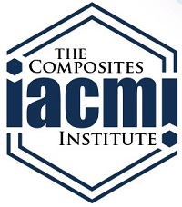
The Institute of Advanced Composites Manufacturing Innovation (IACMI)
Date Launched: Jan. 19, 2015
Focus Area: Advanced Fiber-Reinforced Polymer Composites
http://www.iacmi.org/
Capsule Summary: Advanced composites are currently used for expensive applications like satellites and luxury cars. Researchers at IACMI will work to develop lower-cost, higher-speed, and more efficient manufacturing and recycling processes for them. Bringing these materials down the cost curve can enable their use for a broader range of products including lightweight vehicles with record-breaking fuel economy; lighter and longer wind turbine blades; high pressure tanks for natural gas-fueled cars; and lighter, more efficient industrial equipment
http://www.manufacturing.gov

Slide 46
Manufacturing Innovation Institute for Integrated Photonics
Date Launched: July 27, 2015
Focus Area: Integrated Photonics
http://www.aimphotonics.com/
Capsule Summary: Just as integrated electronic circuits allowed for advanced processing in computers and cellphones, integrated photonic components can pack even more processing power into a single chip, creating new possibilities for computing and telecommunications. An emerging technology for carrying light-waves, integrated photonics has the potential to revolutionize entire industriesï¿½from increasing the carrying capacity of broadband communications ten-fold, to creating needle-free tests for common conditions like diabetes, and to improving imaging capabilities in defense operations.
http://www.manufacturing.gov

Slide 47
Flexible Hybrid Electronics Manufacturing Innovation Institute
Date Launched: August 28, 2015
Focus Area: Flexible Hybrid Electronics
http://www.fhemii.com/
http://www.fhemii.com/
Capsule Summary: Flexible hybrid electronics manufacturing describes the innovative production of electronics and sensors packaging through new techniques in electronic device handling and high precision printing on flexible, stretchable substrates. The potential array of products range from wearable devices to improved medical health monitoring technologies, and will certainly increase the variety and capability of sensors that already interconnect the world. The technologies promise dual use applications in both the consumer economy and the development of military solutions for the warfighter.
http://www.manufacturing.gov

Slide 48
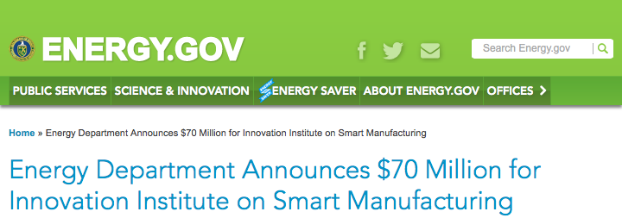
Manufacturing Innovation Institute for Smart Manufacturing
$70 million in funding
Aims to support research and development advancements that can reduce the cost of deployment by 50%
advanced sensors, controls, platforms, modeling
Goal to increase energy efficiency by at least 15 percent
Improve energy productivity by at least 50 percent
Enabling businesses to manufacture more while using less energy and spending less

Slide 49
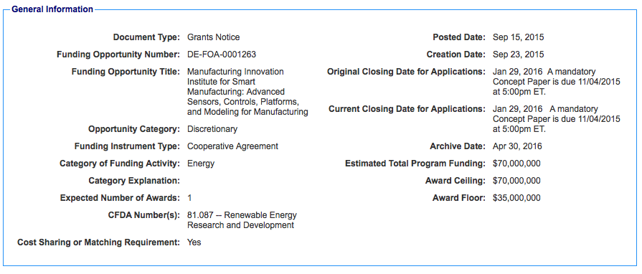
Manufacturing Innovation Institute for Smart Manufacturing Continued
http://www.grants.gov/web/grants/view-opportunity.html?oppId=279015

Slide 50
Revolutionary Fibers and Textile Manufacturing Innovation Institute
More than $150 million in public and private investment funds
Ensures that America leads in the manufacturing of new products from leading edge innovations in fiber science, commercializing fibers and textiles with extraordinary properties
To support an end-to-end innovation ‘ecosystem’ in the U.S. for advanced fibers and textiles manufacturing
This investment drives the application of smart textiles to not only revitalize the domestic textile supply chain, but also creates global export opportunities

Slide 51
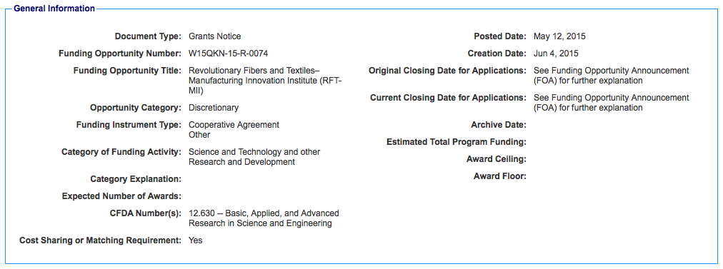
Revolutionary Fibers and Textile Manufacturing Innovation Institute Continued
Launch Date: December 2015
http://www.grants.gov/web/grants/view-opportunity.html?oppId=276514

Slide 52
Small Business Administration Programs
The U.S. Small Business Administration (SBA) was created in 1953 as an independent agency of the federal government to aid, counsel, assist, and protect the interests of small business concerns, to preserve free competitive enterprise, to maintain and strengthen the overall economy of our nation.
Through an extensive network of field offices and partnerships with public and private organizations, SBA delivers its services to people throughout the United States, Puerto Rico, the U. S. Virgin Islands and Guam.
https://www.sba.gov

Slide 53
Small Business Administration Programs
America’s SBDC represents America’s nationwide network of Small Business Development Centers (SBDCs).
The mission of America’s nationwide network of SBDCs is to help new entrepreneurs realize the dream of business ownership, and to assist existing businesses to remain competitive in the complex marketplace of an ever-changing global economy.
Hosted by leading universities, colleges and state economic development agencies, and funded in part by the United States Congress through a partnership with the U.S. Small Business Administration, nearly 1,000 service centers are available to provide no-cost business consulting and low-cost training.
http://americassbdc.org

Slide 54
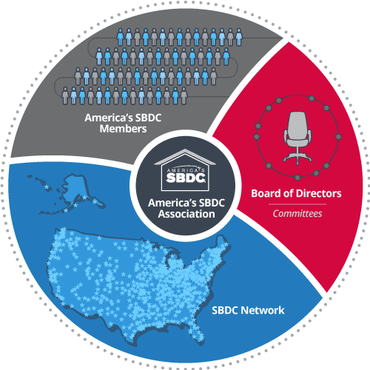
Small Business Administration Programs
Small business owners and aspiring entrepreneurs can go to their local SBDCs for FREE face-to-face business consulting and at-cost training, on topics including:
• Writing business plans
• Accessing capital
• Marketing
• Regulatory compliance
• Technology development
• International trade
http://americassbdc.org

Slide 55
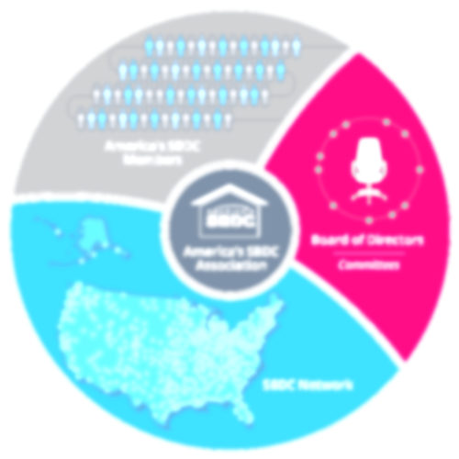
Small Business Administration Programs
SBDCs provide services through professional business advisors such as:
Development of business plans
Manufacturing assistance
Financial packaging and lending assistance
Exporting and importing support
Disaster recovery assistance
Procurement and contracting aid
Market research services
Aid to 8(a) firms in all stages
Healthcare information.
SBDCs serve all populations, including:
minorities
women
veterans
reservists
active duty
personnel with disabilities
and those returning from deployment
people with disabilities
youth and encore entrepreneurs
individuals in low and moderate income urban and rural areas
https://www.sba.gov/tools/local-assistance/sbdc

Slide 56
SCORE
SCORE is a nonprofit association dedicated to helping small businesses get off the ground, grow and achieve their goals through education and mentorship. We have been doing this for over fifty years.
Because SCORE is supported by the U.S. Small Business Administration (SBA) with a network of 11,000+ volunteers, services are delivered at no charge or at very low cost.
https://www.score.org

Slide 57
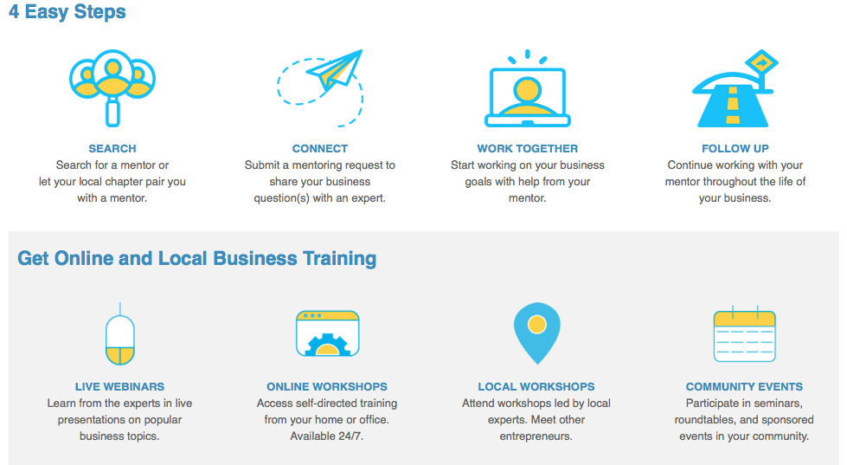
SCORE
https://www.score.org

Slide 58
HUBZone
How the HUBZone Program Works
The SBA regulates and implements the HUBZone program. SBA does the following:
Determines which businesses are eligible to receive HUBZone contracts
Maintains a listing of qualified HUBZone small businesses that federal agencies can use to locate vendors
Adjudicates protests of eligibility to receive HUBZone contracts
Reports to the Congress on the program's impact on employment and investment in HUBZone areas
http://www.sba.gov/hubzone

Slide 59
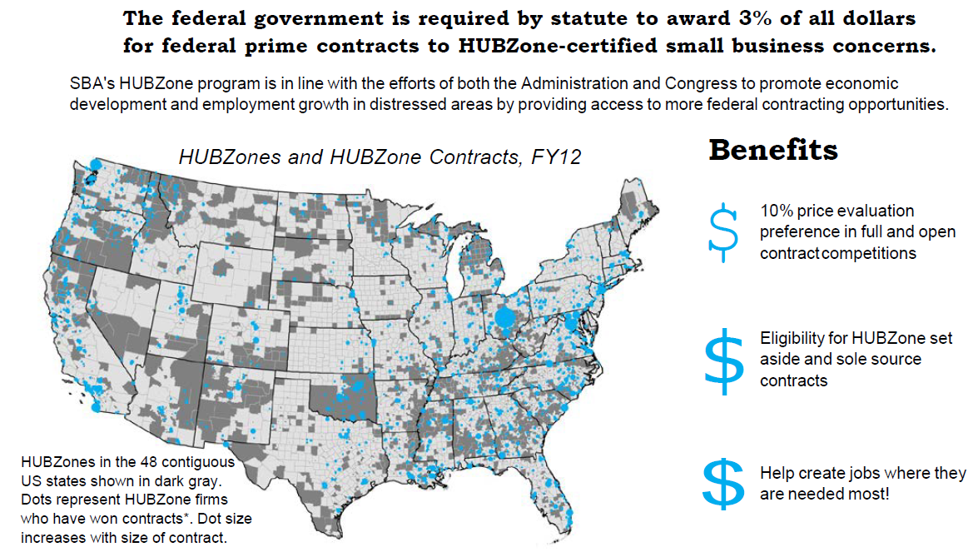
HUBZone Benefits
http://www.sba.gov/hubzone

Slide 60
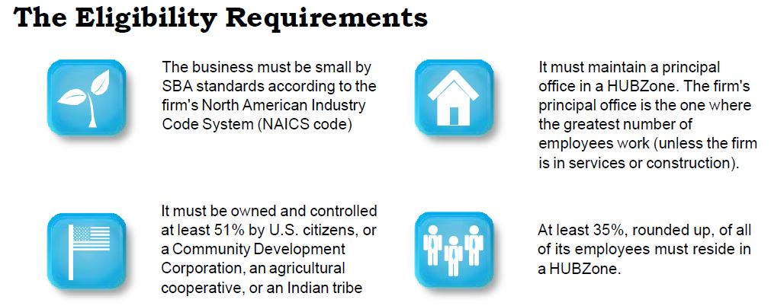
HUBZone Benefits
If you are eligible, visit Applying for the HUBZone Program, as well as Maintaining the HUBZone Certification.
http://www.sba.gov/hubzone

Slide 61
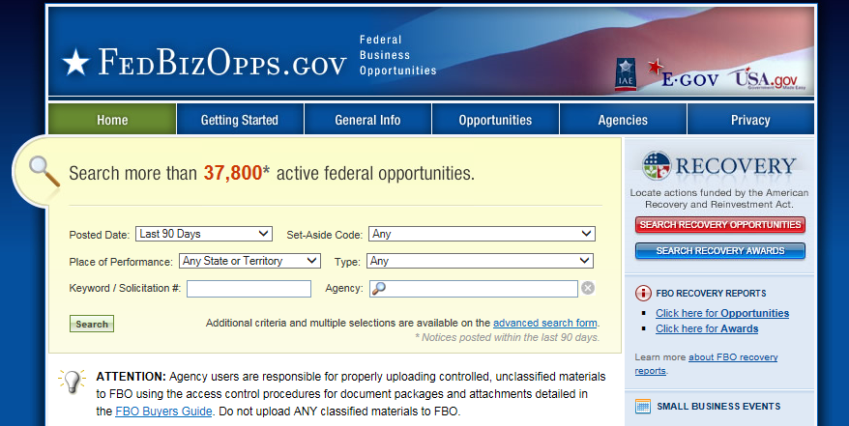
Federal Business Opportunities
FedBizOpps.gov is the single government point-of-entry for Federal government procurement opportunities over $25,000. Government buyers are able to publicize their business opportunities by posting information directly to FedBizOpps via the Internet. Through one portal - FedBizOpps (FBO) - commercial vendors seeking Federal markets for their products and services can search, monitor and retrieve opportunities solicited by the entire Federal contracting community.
https://www.fbo.gov/

Slide 62
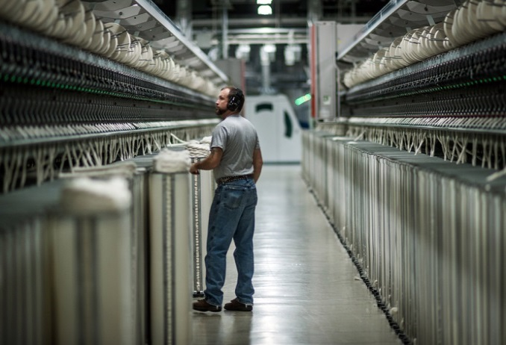
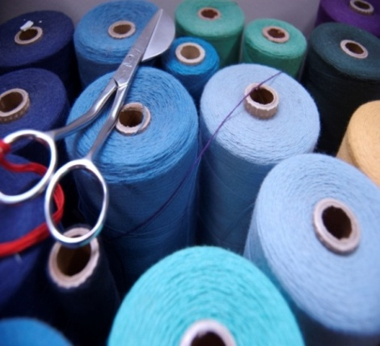
United States: A Global Leader
A strong and diverse textile industry producing a range of high-quality products.
An important economic sector in terms of output and investment with a highly productive workforce:
Output of $71 billion in 2014;
$1.8 billion on capital expenditures in 2014
Up $300 million from 2013
372,400 employees in 2014, 3% of the total manufacturing workforce
Fourth largest single country exporter of textiles, with $14.3 billion in exports in 2014¹.
Largest single country importer of apparel, with imports of $93.1 billion in 2014, 18% of total global imports².
¹Following China, India and Germany. Source: Time Series on International Trade, WTO.
²Source: Time Series on International Trade, WTO

Slide 63
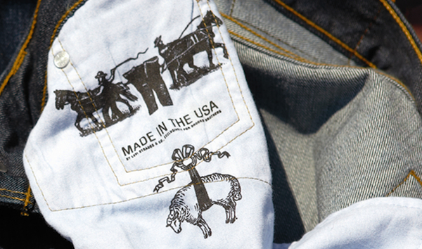
Why Export?
U.S. manufactured products are in high demand around the world and a U.S. ‘brand’ means quality:
“there is not a stronger brand we have than made in the USA…This is our competitive edge”²
Fred P. Hochberg, Chairman and President of Export-Import Bank
According to the U.S. Export-Import Bank, “overall financing for the first time exceeded $35.7 billion and supported $50 billion in exports and approximately 255,000 export related American jobs at more than 3,400 U.S. companies. Small business financing rose over 70% from $3.3 billion in FY 2008 to $6.1 billion in FY 2012.”
http://ashtonandpartners.com/wp-content/uploads/brooks-brothers-main.jpg
Earl Richards, “’Made in the U.S.A’ The Strongest Brand We Have & We Should Export it Globally,” Export Issue No. 20 (Riverside County, California): p. 9.

Slide 64
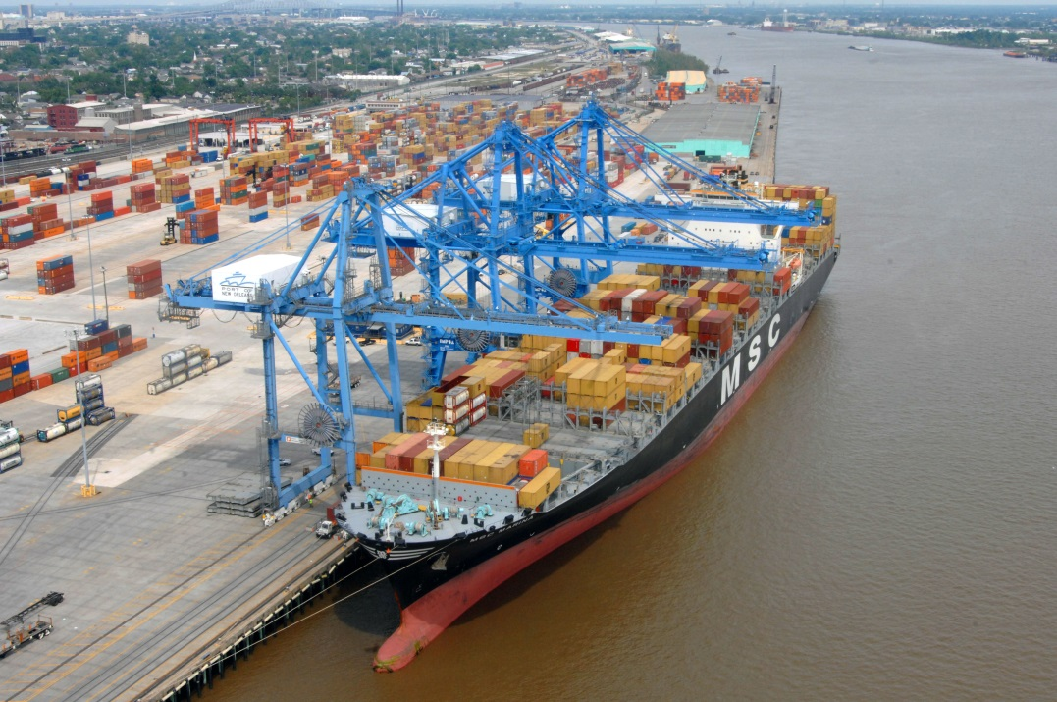
Why Export?
Over 95% of the world’s consumers live outside the U.S. – by 2030, the number of people considered middle class will triple to 1.2 billion with the global economy growing to $72 trillion. Exporting is a great way to reach the global market and these consumers to:
Grow your bottom line Level your business cycle
Use production capabilities fully
Strengthen your domestic market
Increase competitiveness across all markets
https://upload.wikimedia.org/wikipedia/en/d/da/Container_ship_New_Orleans.jpg
Source: A Basic Guide to Exporting 6
http://export.gov/basicguide/

Slide 65
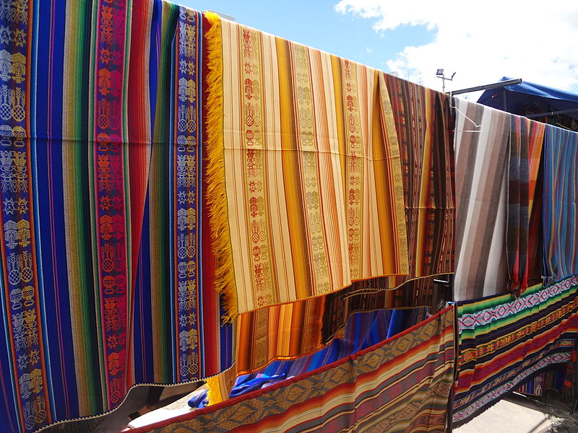
Why Export?
By entering new markets, you will have the opportunity to learn how to compete more successfully, while making more money. In fact, 60% of small companies that engage in exporting derive 20% of their annual profits from export sales. While exporting can be challenging, it provides firms with new opportunities for growth.
“Nationally only 15% of U.S. manufacturers export. That means 85% of U.S. manufacturers could develop a global market strategy to increase market share.”
“Exporting Globally May Not Be Just a Good Growth Strategy But an Essential One,” Export Issue No. 20 (Riverside County, California): p. 4
https://upload.wikimedia.org/wikipedia/commons/thumb/c/c3/Otavalo_Artisan_Market_-_Andes_Mountains_-_South_America_-_photograph_001.JPG/800px-Otavalo_Artisan_Market_-_Andes_Mountains_-_South_America_-_photograph_001.JPG
Source: A Basic Guide to Exporting 6
http://export.gov/basicguide/

Slide 66
National Export Initiative
To strengthen America’s economy, support additional jobs here at home, and ensure long-term, sustainable growth, President Obama launched a government-wide strategy to promote exports. The National Export Initiative (NEI) is one essential component of that strategy.
The Obama Administration has made it a top priority to improve the conditions that directly affect the private sector’s ability to export, working to remove trade barriers abroad, help firms of all sizes and farmers overcome hurdles to entering new markets, and assist with financing. In addition, we have renewed and revitalized our efforts to promote American exports abroad.
http://www.trade.gov/nei/

Slide 67
Exporting: Essential Steps to Success
U.S. Schedule B
A Schedule B number is a 10-digit number used in the United States to classify physical goods for export to another country. The Schedule B is based on the international Harmonized System (HS) of 6-digit commodity classification codes. There is a Schedule B number for every physical product, from paperclips to airplanes.
You can find your Schedule B number using the free online Schedule B Search accessible through htp://www.census.gov/scheduleb. If you need export classification assistance, email ftd.scheduleb@census.gov or call 1-800-549-0595, Menu Option #2.
The Schedule B is revised once annually.
New Codes are usually effective January 1.
www.census.gov/scheduleb

Slide 68
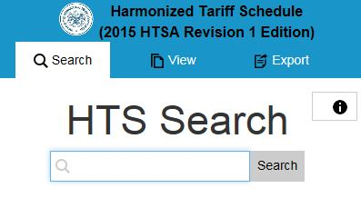
Exporting: Essential Steps to Success
Harmonized Tariff System (HTS)
The international Harmonized System (HS) is administrated by the World Customs Organization and serves as the foundation for the import and export classification systems used in the United States. The United States (U.S.) import classification system, the Harmonized Tariff Schedule (HTS) is administered by the U.S. International Trade Administration Commission (USITC).
http://hts.usitc.gov

Slide 69
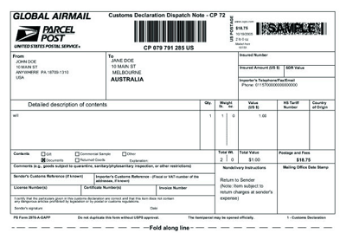
Exporting: Essential Steps to Success
Harmonized Tariff System (HTS)
The Harmonized Tariff System (HTS) assigns a number to each product that is traded internationally to insure that Customs officers and statisticians around the world are referring to the same thing when classifying a product. Almost all countries now use the harmonized tariff system.
https://about.usps.com/postal-bulletin/2005/html/pb22167/internationmail_gap10.gif
The Harmonized Tariff Schedule is only harmonized internationally to 6 digits, while the U.S. HTS goes to 10 digits. HS numbers and Schedule B numbers will be the same up to the first 6 digits as the importing country's classification code.
http://hts.usitc.gov

Slide 70
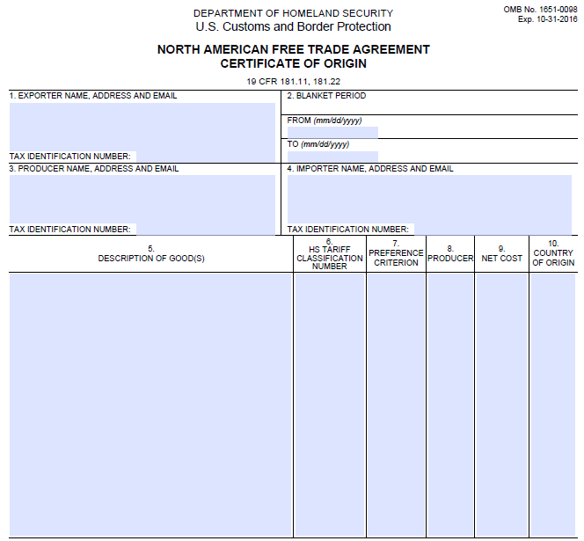
Exporting: Essential Steps to Success
Why you need to know your product’s Schedule B and HS numbers:
To determine applicable import tariff rates and whether a product qualifies for a preferential tariff under a Free Trade Agreement;
To file the Electronic Export Information in the Automated Export System (AES); and
To complete shipping documents, such as certificates of origin.
How to identify your product’s Schedule B number Video
http://www.export.gov/logistics/eg_main_018119.asp

Slide 71
Exporting: Essential Steps to Success
Legal Aspects of Market Preparation
Be familiar with US export laws and necessary documentation:
Foreign Corrupt Practices Act
http://www.justice.gov/criminal-fraud/foreign-corrupt-practices-act
Anti-Boycott Act
Export Controls
Free Trade Agreement Requirements
Export Restrictions
Harmonized Tariff Schedule
Office of Foreign Asset Controls - List of Specially Designated Nationals and Blocked Persons
http://www.ustreas.gov/offices/enforcement/ofac/
http://www.export.gov

Slide 72
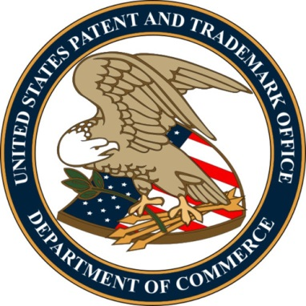
Protecting Intellectual Property (IP)
If you’ve got a great idea, logo, business name, or even an invention, you need to protect it. The steps involved in filing for patents, trademarks or copyrights are covered in this section, along with additional resources that can help you safeguard your intellectual properties, such as having employees or vendors sign non-disclosure agreements.
Understand Intellectual Property and How to Protect your Business – This business guide from STOPfakes.gov is an essential starting point for understanding your intellectual property rights and finding the right protection for your business.
Applying for a Patent – Learn more about how to apply for a patent through the U.S. Patent and Trademark Office (USPTO).
https://www.sba.gov/content/intellectual-property-law

Slide 73
Protecting Intellectual Property (IP)
℠™ ®
Registering a Trademark or Service Mark – Find out how to file for trademark or service mark protection for your business name, symbols and logos.
Copyright your Work – Books, movies, digital works, and musical recordings are all examples of copyrighted works. Refer to this guide from U.S. Copyright Office for more information on what protection copyright affords and the process of copyrighting your work.
This web-based IP Awareness Assessment tool developed by the U.S. Patent and Trademark Office (USPTO) and the National Institute of Standards and Technology (NIST) is designed to help manufacturers, small businesses, entrepreneurs and independent inventors easily assess their knowledge of intellectual property (IP).
https://www.sba.gov/content/intellectual-property-law

Slide 74
Exporting: Essential Steps to Success
Summary For Success In Exporting
Small and medium-sized companies fear foreign markets due to language barriers, currency transfers, a lack of education in shipping procedures, and a fear of taking a chance
How can this change?
Invite a freight forwarder to your company for an informational exchange
Invite an international banker to your company for discussions
Attend educational seminars
Hire a graduate student intern to help with research/strategy
Read, research – develop a country strategy
http://www.export.gov

Slide 75
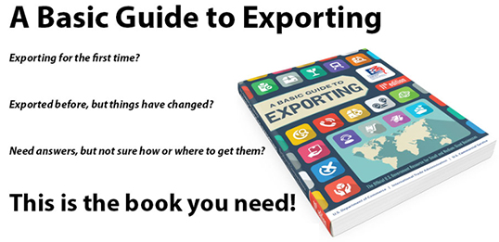
Exporting: Essential Steps to Success
Basic Guide to Exporting eBook
A Basic Guide to Exporting addresses virtually every issue a company looking to export might face. Numerous sections, charts, lists and definitions throughout the book’s 19 chapters provide in-depth information and solid advice about the key activities and issues relevant to any prospective exporter, including:
Getting things rolling
Delivering your product
Financial issues
Overseas activities
Legal issues
http://www.export.gov

Slide 76
Conclusion
Take advantage of all the information and helpful data on the OTEXA website: www.otexa.trade.gov
Exporting is critical to the bottom-line of all companies
Export assistance is given throughout this presentation. Please note the U.S. Department of Commerce has offices in each state that can also provide assistance and support
Selling to the federal government can be financially advantageous and relatively simple. You can achieve both domestic and international exposure, branding, and an enhanced revenue stream
Your website is a window to the world for your business. You are selling a lifestyle concept. Make sure your website reflects your state-of-the-art design and best technology so that you broadcast your company’s message and image

Slide 77
Amelia Earhart’s Quote On Courage
“The most difficult thing is the decision to act. The rest is merely tenacity. The fears are paper tigers. You can do anything you decide to do. You can act to change and control your life and the procedure. The process is its own reward.”
https://commons.wikimedia.org/wiki/File:Amelia_Earhart_LOC_hec.40747.jpg

Slide 78
OTEXA Contact
Ms. Mary Lynn Landgraf
Senior International Trade Specialist
Office of Textiles and Apparel
U.S. Department of Commerce
1401 Constitution Ave., NW, Room 30003
Washington, DC 20230
Tel: (202)-482-7909
Fax: (202)-482-2331
Email: mary-lynn.landgraf@trade.gov
http://otexa.trade.gov

